Slide 1



Dovi Perla
RXJS and Reactive Programming

Slide 2
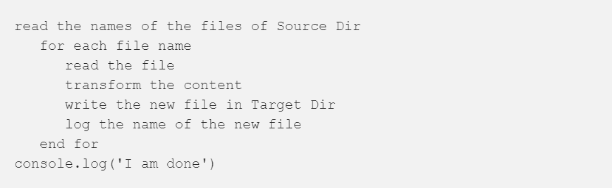
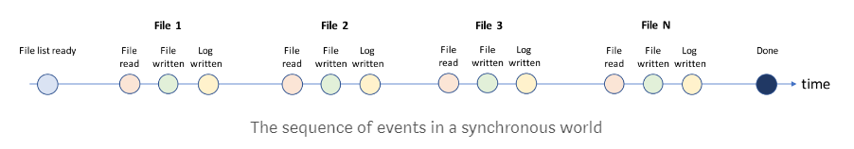
Synchronous implementation

Slide 3
Asynchronous non-blocking environment like Node.js
Node.js is an asynchronous non-blocking execution environment for JavaScript
Non-blocking means that Node.js does not wait for I/O or Network operations to complete before moving to the execution of the next line of code

Slide 4
Non_promise_controller.js

Slide 5
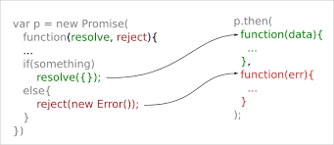
The paradise of Promise
Using Promise we can make the code look again sequential, without interfering with the asynchronous nature of Node.js.
Using promise Allows the division of the code into layers.

Slide 6
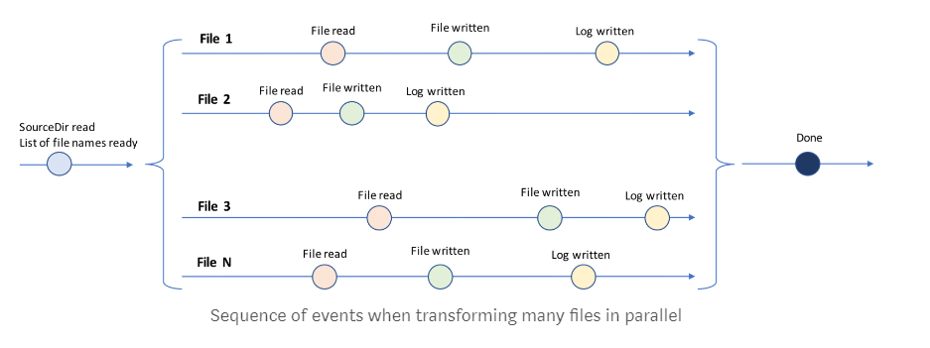
But… Processing many files
The parallel processing of each file makes the use of Promises more complex

Slide 7
promise_controller.js

Slide 8
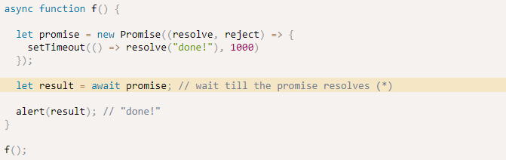
Async -Await
The word “async” before a function means - a function always returns a promise.
The keyword “await” makes JavaScript wait until that promise settles and returns its result.

Slide 9
Async Await

Slide 10

Reactive programming
Reactive programming is programming with asynchronous data streams.
You are able to create data streams of anything
RxJS create amazing toolbox of functions to combine, create and filter any of those streams.
The "listening" to the stream is called subscribing. The functions we are defining are observers. The stream is the subject (or "observable") being observed

Slide 11
Reactive programming
Observables as newsletters
For each subscriber a new newsletter is created. They are then only send to those people, and not to anyone else.
The sender decides when you get it but all you have to do is just wait until it comes straight into your inbox.

Slide 12
Reactive programming
Pull
When pulling, the data consumer decides when it get’s data from the data producer. The producer is unaware of when data will be delivered to the consumer.
Every javascript function uses the pull. The function is a Producer of data, and the code that calls the function is consuming it by “pulling” out a single return value from its call.
Push
The data producer (the creator of the newsletter) decides when the consumer (the subscriber to the newsletter) gets the data.

Slide 13
Reactive programming
Promises are the most common way of push in JavaScript today. A promise (the producer) delivers a resolved value to registered callbacks (the consumers)
Observables are a new way of pushing data in JavaScript. An observable is a Producer of multiple values, “pushing” them to subscribers.

Slide 14
Promises vs Observables
One value
promises always return only one value
Cancelable
If the promise is handed to you, the process that will produce that promise’s resolution is already underway, and you generally don’t have access to prevent that promise’s resolution from executing.

Slide 15
Observables in Angular

Slide 16
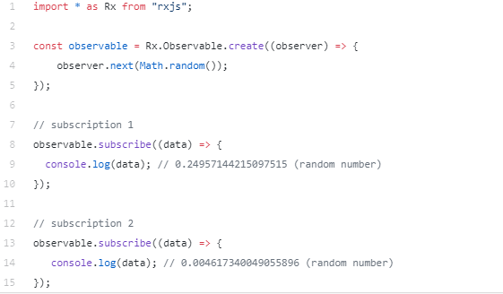
Subject
An Observable by default is unicast. Unicasting means that each subscribed observer owns an independent execution of the Observable

Slide 17
Subject
Subjects are like EventEmitters, they maintain a registry of many listeners. When calling subscribe on a Subject it does not invoke a new execution that delivers data. It simply registers the given Observer in a list of Observers.

Slide 18
Subject

Slide 19


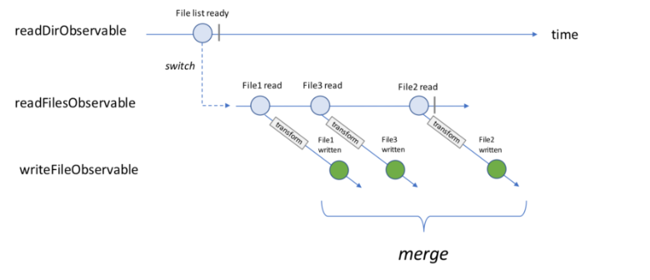
Operators (Switch map && Marge)

Slide 20
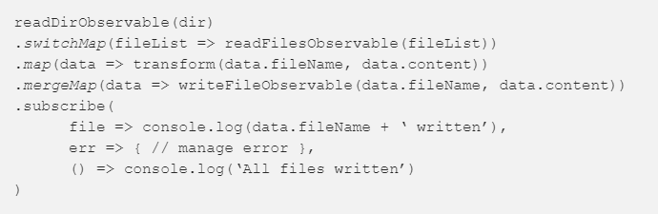
Operators (Switch map && Marge)

Slide 21
Summery
Reactive provides a new way to work with asynchronous non-blocking execution environment.
RxJS is a library to use reactive in javascript.
In reactive we talk about stream of events called “Observable” and the ability to Subscribe to events and managed them.

Slide 22

https://github.com/dovip/sdp_dec_2018

Slide 23
Credits
https://medium.freecodecamp.org/rxjs-and-node-8f4e0acebc7c
https://netbasal.com/rxjs-six-operators-that-you-must-know-5ed3b6e238a0
https://medium.com/@luukgruijs/understanding-rxjs-subjects-339428a1815b

Slide 24


